Slide 1
ENGG*6990 - Final Project Computer Eng
Arpit Vaghela – Student Id: 1262011

Slide 2
Overview
Introduction: Large Language Models (LLMs) are advanced AI systems capable of generating human-like text.
Objective: Propose methods to enhance security and coherence in LLMs, focusing on watermarking and cluster bias.
Key Sections:
Related Works
Methodology
Experiment Details
Results
Conclusion & Future Works

Slide 3
Introduction
LLMs (e.g., GPT) are dominent in text generation but shows risks like misinformation and dataset contamination.
Solution: Use watermarking for detecting synthetic text and cluster bias for coherence.
Goal: Balance security and performance in LLM outputs.
Notes:
LLMs Benefits and Risks:
Powerful for text generation but risks include misinformation, cheating, and bad training data.
Proposed Solutions:
Watermarking: Adds hidden marks to detect AI-generated text.
Cluster Bias: Ensures the text is clear and coherent.
Goal:
Combine both methods to balance security and quality.
This keeps the key points short and easy to explain.

Slide 4
Related Works (Overview)
Emerging Risks of LLMs:
Applications: Generating text, code, and more.
Risks: Misinformation, academic dishonesty, dataset contamination.
Watermarking:
Solution to identify synthetic text.
Effective for curbing risks like intellectual property theft and ensuring integrity.
Challenges: Maintaining text quality in low-entropy sequences.
Biasing Techniques:
Used for coherence and robustness in generated text.
Techniques like clustering improve thematic consistency.
Notes:
Risks of LLMs:
LLMs like GPT can generate human-like text but may cause problems:
Misinformation: Spreading false information.
Cheating: Misuse in academics.
Dataset Issues: Synthetic text can harm training data quality.
Watermarking:
Adds hidden markers to AI-generated text to detect misuse.
Hard to apply in predictable outputs like code.
Biasing Techniques:
Makes generated text more consistent and coherent.
Uses token clustering to improve thematic relevance.

Slide 5
Related Work (Watermarking Techniques)
Hard Red List Watermarking:
Blocks specific tokens; easy detection but may affect text flow.
Soft Red List Watermarking:
Encourages specific tokens (green list) instead of excluding others; balances detection and quality
Cluster-Based Biasing:
Groups tokens to ensure coherence; ideal for long or complex text.
Applications:
Intellectual property protection and detecting AI-generated content
Notes:
Hard Red List:
Blocks certain words from being generated.
Easy to detect but can make text sound unnatural.
Soft Red List:
Encourages some words without fully blocking others.
Balances detection and text quality.
Cluster Biasing:
Groups similar words to make text more meaningful.
Helps keep long outputs consistent.
o

Slide 6
Related Works (Our Proposal)
Integrating Watermarking and Cluster Biasing:
Introduced by Dr. Qi Li.
Improves security and coherence of text.
Balances strength and quality of the text.
Benefits:
Better tracking of AI-generated content.
Protects against attacks on the model.
Results in better quality text.
Notes:
ntegrating Watermarking and Cluster Biasing:
Purpose: Improves both security and coherence of generated text.
Advantage: Balances robustness with text quality.
Benefits:
Enhanced Model Traceability: Better tracking of AI-generated content.
Protection Against Adversarial Manipulation: Safeguards against attacks targeting model outputs.
Better Overall Text Quality: Ensures coherent, high-quality generated text.

Slide 7
METHODOLOGY (Model Selection)
GPT-2: Text generation model by OpenAI, known for producing contextually accurate text.
OPT: Open-source model by Meta, similar to GPT, with smaller variants like OPT-350M.
Choice: GPT-2 Medium for quality, OPT-350M as an open-source alternative.

Slide 8
Methodology (Token Sampling & Watermarking)
Clustering Tokens: Group tokens by meaning, using similarity measures like cosine.
Token Sampling: Select diverse tokens for interesting and meaningful text.
Watermarking: Add hidden patterns to track text origin while maintaining coherence.
Notes:
Clustering Tokens:
Concept: Tokens are the building blocks of language models. Each token represents a word or part of a word in text generation.
Clustering Approach: By using similarity measures like cosine similarity, we can group tokens that share similar meanings. This helps the model understand and generate more contextually relevant text.
Example: Tokens like "dog" and "puppy" might be clustered together due to their similarity.
Purpose: Clustering helps the model in understanding synonyms and related words, improving its ability to generate diverse yet contextually appropriate text.
Token Sampling:
Concept: Token sampling refers to the technique of selecting a token from the set of possible tokens at each step of text generation.
Sampling Methods:
Greedy Sampling: Always selects the token with the highest probability, leading to more predictable text but less creativity.
Temperature Sampling: Adjusts the likelihood of selecting less probable tokens, allowing for more creative outputs (higher temperature = more diversity).
Top-k Sampling: Limits the number of tokens considered to the top k tokens, balancing randomness and control.
Top-p (Nucleus) Sampling: Chooses tokens based on cumulative probability, giving more flexibility in output generation.
Purpose: Sampling methods allow control over the diversity and creativity of generated text. By adjusting how tokens are sampled, you can influence the style, tone, and coherence of the output.
Watermarking:
Concept: Watermarking refers to the technique of embedding hidden patterns or identifiers into the generated text, making it traceable back to the model.
Purpose: The goal is to detect if specific content was generated by a particular model or to track the usage of generated content.
Steganographic Watermarking: Involves subtly modifying the text to include invisible markers or patterns (such as uncommon word choices or structured sentence patterns).
Visibility: Watermarking should not disrupt the natural flow of the text, making it undetectable to most readers while still being identifiable by the model creator.
Example: A watermark might involve introducing certain rare phrases or patterns that the model uses only when generating specific content.

Slide 9
Experiment Details
Overview:
Model Selection
Gamma and Delta Configurations
Evaluation metrics
Input Dataset

Slide 10
Experiment Details (Model Size Comparison)
GPT-2 (medium):
355M parameters
Better context understanding and diversity
Ideal for longer sequences and complex tasks
OPT-350M:
350M parameters
Good balance between efficiency and quality
Better at handling long text and more nuanced responses

Slide 11
Experiment Details (Gamma & Delta Configurations)
Gamma (𝛾): Size of the green list
High 𝛾: Larger green list
Low 𝛾: Smaller green list
Delta (𝛿): Preference for the green list
High 𝛿: Strong preference for green list
Low 𝛿: Less preference for green list
Medium 𝛾, Medium 𝛿: Balanced output (coherent and diverse)
Notes:
Gamma (𝛾): Size of the green list (preferred options)
High 𝛾: Larger green list → Fluent but less diverse output
Low 𝛾: Smaller green list → Focused but less diverse output
Delta (𝛿): Preference for the green list
High 𝛿: Strong preference for green list → More coherent but less diverse output
Low 𝛿: Less preference for green list → More diverse but less coherent output
Medium 𝛾, Medium 𝛿: Balanced output (coherent and diverse)

Slide 12
(Experiment Details) Evaluation Metrics
BLEU: Measures how similar the generated text is to the reference text.
ROUGE: Measures overlap of n-grams between generated text and reference.
Perplexity: Measures how confident the model is in predicting the next word.
Notes:
BLEU (Bilingual Evaluation Understudy Score)
Purpose: Measures the quality of text generated by comparing it with a reference text (typically human-generated).
How it Works: BLEU calculates precision by counting n-grams (sequences of words) in the generated text that match n-grams in the reference text. It also incorporates a brevity penalty to avoid short answers.
Range: 0 (no match) to 1 (perfect match).
Strength: Useful for tasks like machine translation, where matching exact phrases or terms is important.
Limitations: Does not account for word order or synonyms, which may lead to lower scores for fluent but different outputs.
ROUGE (Recall-Oriented Understudy for Gisting Evaluation)
Purpose: Primarily used for evaluating text summarization by comparing n-grams, word sequences, or word pairs between the generated and reference text.
How it Works: ROUGE computes recall, precision, and F1 score by comparing n-grams in the generated text with those in the reference. It often focuses on overlap of longer n-grams (e.g., 4-grams or 5-grams).
Range: Can range from 0 (no overlap) to 1 (perfect overlap).
Strength: Focuses on the recall of important content from the reference text, making it useful for summarization tasks.
Limitations: Like BLEU, it can miss variations in phrasing that are still semantically correct.
Perplexity
Purpose: Measures how well a probability model predicts a sample. Specifically, it gauges how confident the model is in predicting the next token (word or character) in a sequence.
How it Works: Perplexity is calculated as the exponentiation of the average negative log-likelihood of the model’s predictions. Lower perplexity indicates the model is better at predicting the next word (less surprise).
Range: Higher perplexity indicates worse performance, while lower perplexity indicates better performance.
Strength: It is commonly used in language models and is good for assessing how well a model can handle unseen data.
Limitations: It doesn't necessarily correlate with human judgments of text quality and can be misinterpreted as it rewards models that are overconfident but inaccurate.

Slide 13
(Experiment Details) Input Dataset
Donkey Kong Country Story (Fictional Dataset)
Source: Wikipedia
Description: A fictional narrative about Donkey Kong’s adventures to recover stolen bananas.
2. New York Times Article on TikTok Ban (Factual Data)
Source: New York Times
Description: A factual article discussing the potential ban of TikTok and related concerns.

Slide 14
Experiment Results
Overview
BLEU Scores:
Measure of text similarity to human-generated output.
ROUGE Scores:
Focused on n-gram overlap.
Perplexity:
Indicates model confidence in generating coherent sequences.

Slide 15
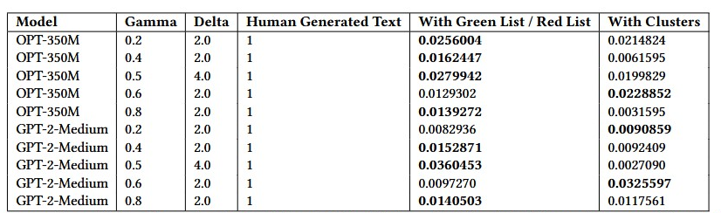
Bleu Scores – Dataset 1 (Experiment Results)
Conclusion:
Green List/Red List is the most effective method.
GPT-2-Medium performed better overall.
Notes:
Methods Evaluated:
Green List/Red List
Clusters
Key Findings:
Green List/Red List outperformed Clusters across models.
GPT-2-Medium with Green List/Red List (Gamma 0.5, Delta 4.0) achieved the highest BLEU score (0.0360).

Slide 16
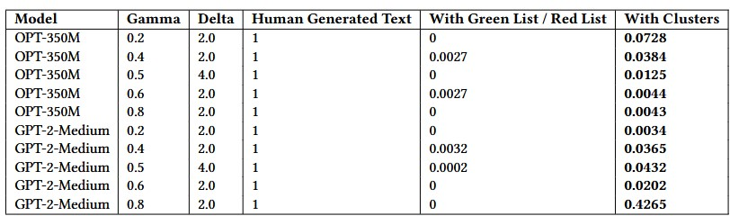
Bleu Scores – Dataset 2 (Experiment Results)
Conclusion:
Clusters is the most effective watermarking method.
GPT-2-Medium demonstrated superior performance overall

Slide 17
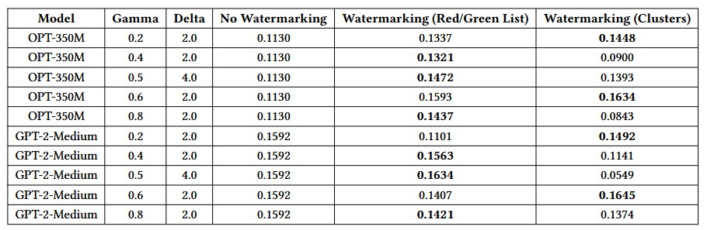
ROUGE-L – Dataset 1 (Experiment Results)
Conclusion:
Both Green/Red List and Clusters improved ROUGE-L scores, with Clusters slightly outperforming in specific configurations.
GPT-2-Medium achieved the highest ROUGE-L score using Clusters at Gamma 0.6, Delta 2.0, making it the best model-method pairing.
Notes:
Results: ROUGE-L Analysis
Methods Evaluated:
No Watermarking
Watermarking (Green/Red List)
Watermarking (Clusters)
Key Findings:
OPT-350M:
Best performance with Clusters at Gamma 0.6, Delta 2.0 (ROUGE-L: 0.1634).
Green/Red List also performed well (0.1593), showing comparable effectiveness.
GPT-2-Medium:
Best performance with Clusters at Gamma 0.6, Delta 2.0 (ROUGE-L: 0.1645).
Green/Red List performed slightly lower (0.1634), but still effective.
No Watermarking:
Consistently lower scores compared to watermarking techniques, confirming their added value.
Conclusion:
Both Green/Red List and Clusters improved ROUGE-L scores, with Clusters slightly outperforming in specific configurations.
GPT-2-Medium achieved the highest ROUGE-L score using Clusters at Gamma 0.6, Delta 2.0, making it the best model-method pairing

Slide 18
ROUGE-L – Dataset 2 (Experiment Results)
Conclusion:
Clusters consistently outperformed both Green/Red List and No Watermarking across models
The best BLEU score was achieved with OPT-350M using Clusters at Gamma 0.2, Delta 2.0 (BLEU: 0.1942)

Slide 19
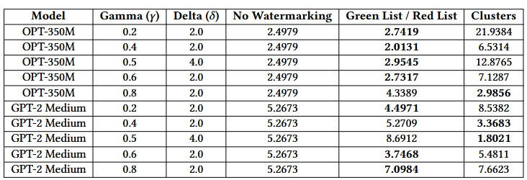
Perplexity Scores – Dataset 1 (Experiment Results)
Conclusion:
GPT-2 Medium performs better across watermarking methods, with lower perplexity scores compared to OPT-350M.
Green List / Red List consistently outperforms Clusters in terms of perplexity, with more stable and lower values.

Slide 20
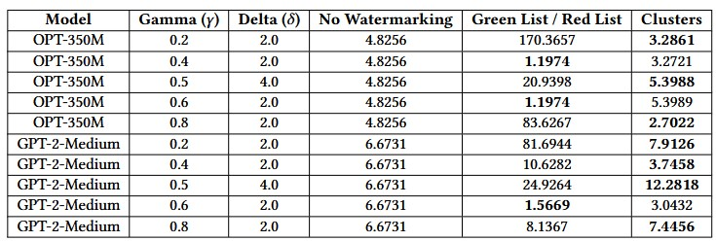
Perplexity Scores – Dataset 2 (Experiment Results)
Conclusion:
GPT-2 Medium performs better across watermarking methods, with lower perplexity scores compared to OPT-350M.
Green List / Red List generally yields the lowest perplexity scores across different configurations, showing better consistency than Clusters.

Slide 21
Conclusion and Future Works
Final Conclusion:
Best Model: GPT-2 Medium outperforms OPT-350M across all metrics.
Best Watermarking Method: Cluster-based watermarking outperformed others on Dataset 2, showcasing its potential for improved performance in specific contexts. Green List / Red List remained strong but less effective than clusters in some cases.

Slide 22
Improve Cluster-Based Watermarking: Make it more effective for different datasets.
Test More Gamma (𝛾) and Delta (𝛿) Values: Explore a wider range for better results.
Use Larger Datasets: Try bigger and more varied datasets.
Check Model Performance: See how watermarking affects the model’s accuracy in different tasks.
Test Long-Term Watermarking: Check how well the watermark lasts over time and in different conditions.
Notes:
Improve Cluster-Based Watermarking:
Goal: Enhance the performance of the cluster-based watermarking method, which showed promising results in some cases but needs further optimization to consistently outperform other methods.
Approach: Investigate different clustering algorithms, such as k-means or DBSCAN, to see if the clustering technique can better identify and encode watermarks in model outputs. This could improve its robustness and accuracy.
Objective: Test across various domains (e.g., factual vs. fictional data) to check if the clustering method remains effective in different scenarios.
Test More Gamma (𝛾) and Delta (𝛿) Values:
Goal: Explore a wider range of gamma and delta values to better understand their impact on watermarking effectiveness and model performance.
Approach: Run experiments with different combinations of gamma (which controls the degree of modification in the model) and delta (which influences watermark strength). This can help identify an optimal range that works best for watermark embedding while minimizing any negative effects on the model's performance.
Objective: Fine-tune these hyperparameters to find a more balanced trade-off between watermarking strength and model accuracy.
Use Larger Datasets:
Goal: Validate the watermarking methods on larger, more diverse datasets to assess their generalizability and robustness.
Approach: Expand the current dataset to include more samples, particularly in underrepresented categories, or use more complex datasets like multilingual or multimodal data. This will help assess whether the proposed watermarking techniques hold up under real-world conditions and with more varied inputs.
Objective: Test the scalability of the watermarking approach and check if it can maintain effectiveness as the dataset size grows.
Check Model Performance:
Goal: Investigate how watermarking affects the overall performance of models, particularly in terms of accuracy, speed, and efficiency.
Approach: Evaluate the models' performance on tasks beyond watermarking (e.g., text generation, classification) to see if watermarking degrades their ability to perform those tasks. Compare results with no watermarking and assess trade-offs between model performance and watermarking security.
Objective: Ensure that watermarking does not significantly harm model accuracy, and if any degradation occurs, determine how to mitigate it.
Test Long-Term Watermarking:
Goal: Explore how well the watermarks persist over time and in various deployment conditions.
Approach: Test how long the watermark remains detectable after fine-tuning, adversarial attacks, or model updates. This would involve assessing the resilience of the watermarking method across model version changes, as well as examining its robustness against attempts to remove or alter it.
Objective: Ensure that the watermark is durable over time and not easily tampered with, particularly in production environments or post-deployment scenarios.

